Slide 1
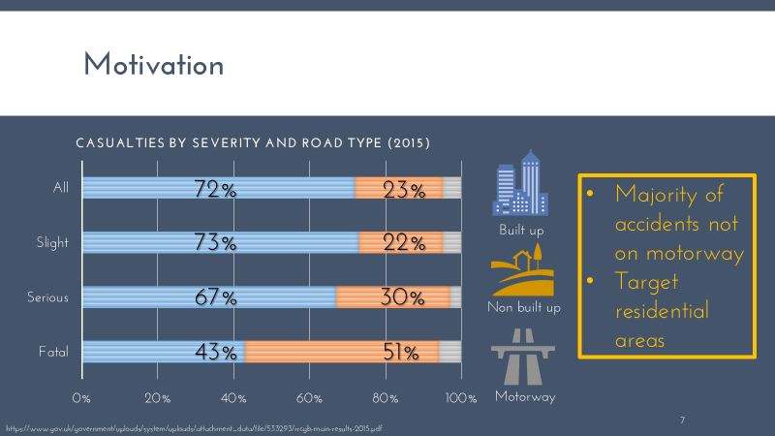
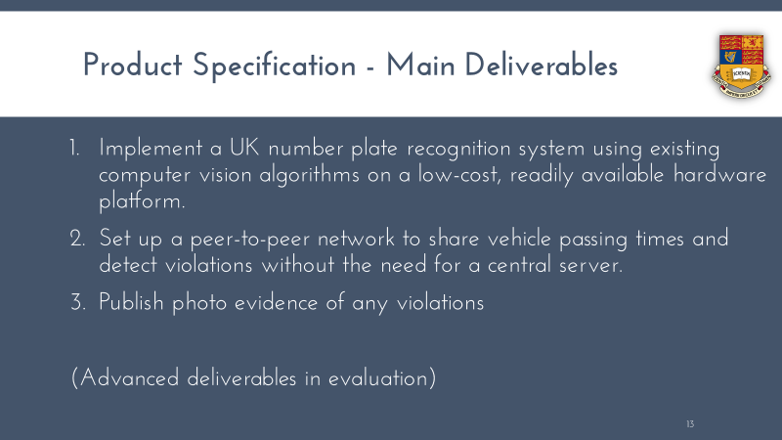
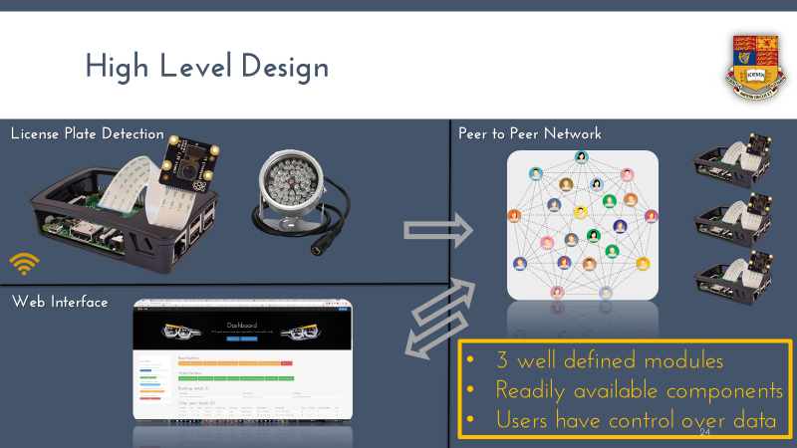
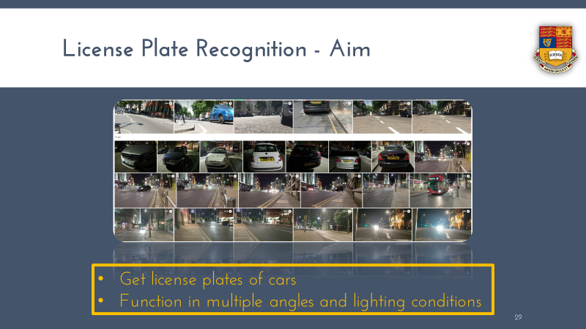
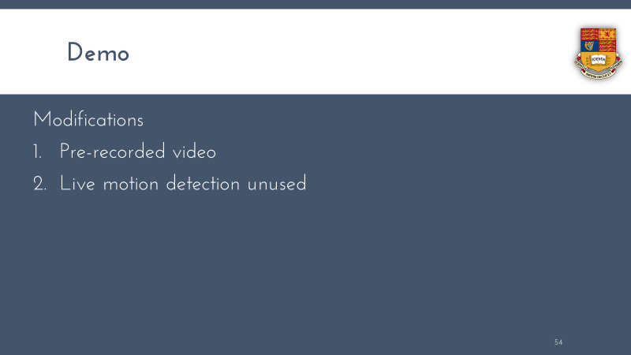
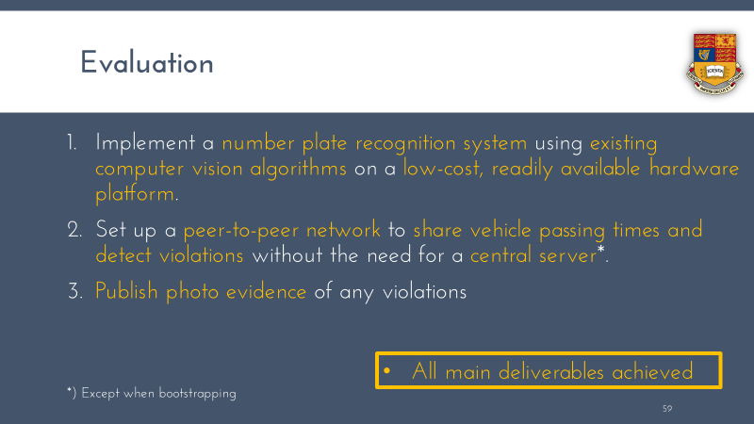
Agenda
This slide is used as a ‘Template' for generating agenda slides. Please do not delete this slide.
Adjust the design of this slide and click the 'Sync Agenda' (in Agenda Lab) to replicate the design in the other slides.
Notes:
This notes page is used to store data - Do not edit the notes. UFBUVGVtcGxhdGVNYXJrZXI=@VGl0bGUgMQ==@UHB0TGFic0FnZW5kYV8mXkBWaXN1YWxBZ2VuZGFJbWFnZV8mXkBNb3RpdmF0aW9uXzI=@UHB0TGFic0FnZW5kYV8mXkBWaXN1YWxBZ2VuZGFJbWFnZV8mXkBQcm9qZWN0IFNwZWNpZmljYXRpb25fMw==@UHB0TGFic0FnZW5kYV8mXkBWaXN1YWxBZ2VuZGFJbWFnZV8mXkBIaWdoIExldmVsIERlc2lnbl80@UHB0TGFic0FnZW5kYV8mXkBWaXN1YWxBZ2VuZGFJbWFnZV8mXkBJbXBsZW1lbnRhdGlvbiBhbmQgVGVzdGluZ181@UHB0TGFic0FnZW5kYV8mXkBWaXN1YWxBZ2VuZGFJbWFnZV8mXkBEZW1vXzY=@UHB0TGFic0FnZW5kYV8mXkBWaXN1YWxBZ2VuZGFJbWFnZV8mXkBFdmFsdWF0aW9uIGFuZCBDb25jbHVzaW9uXzc=@2188161514

Slide 2

Distributed Road Traffic Speed Monitoring
An EE4-T Final Year Project
Jeremy Chan
w/ Dr. Ed Stott
w/ Dr. Christos Papavassiliou
Notes:
Good morning.
My name is Jeremy Chan, and welcome to my final year project presentation, on creating a distributed road traffic speed monitoring system.

Slide 3
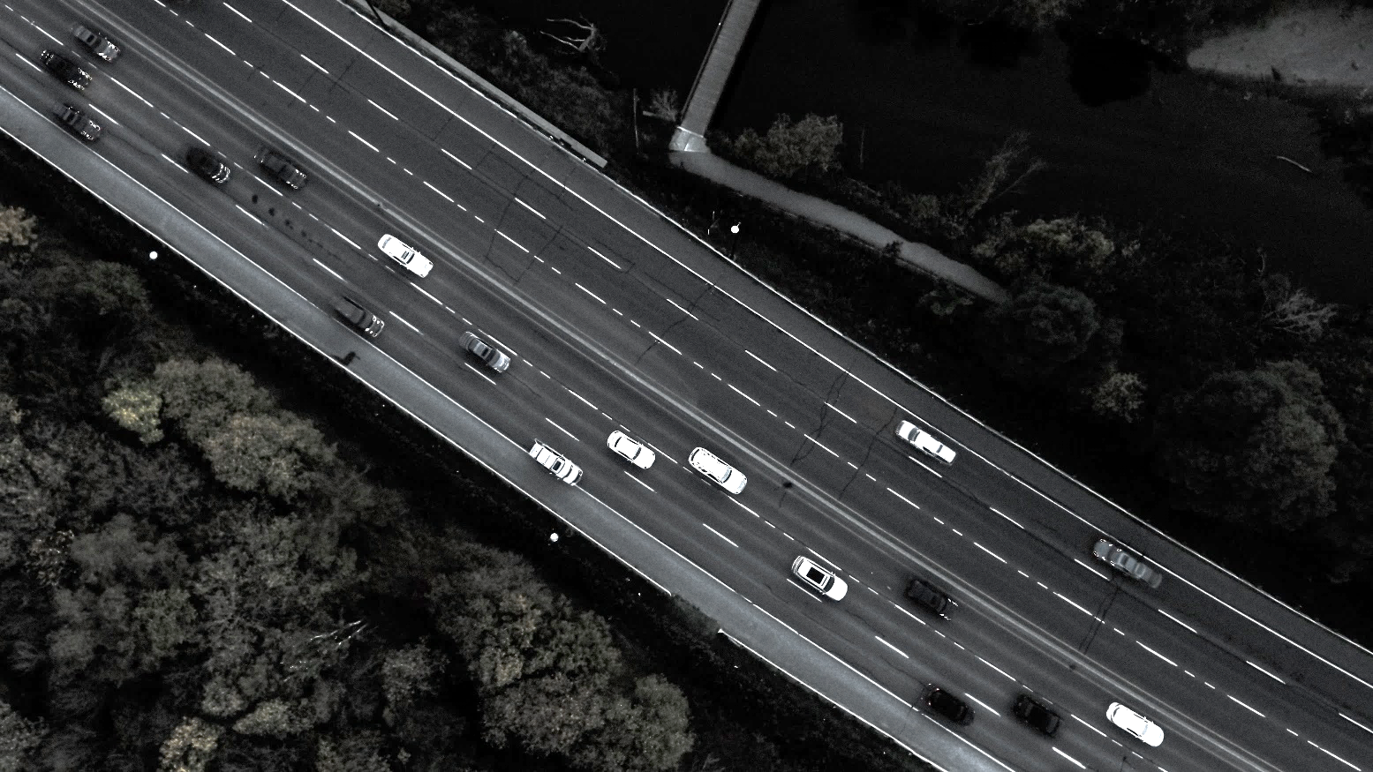
At a glance…
Implementation based project
Catch speeding motorists using a camera and Raspberry Pi
Existing license plate recognition (LPR) technologies
New peer to peer network (P2P)
No government controlled central server
Social posting
Notes:
At a glance, this project is an implementation based project.
It uses a camera connected to a Raspberry Pi to catch speeding motorists by detecting their license plates, sharing it with others, and working out the average speed of the vehicle.
Details of speeding motorists can then be posted online on social platforms.
It leverages existing LPR technologies, but creates a NEW P2P network, eliminating the need for a central, government controlled, server
The rundown on this presentation is a general overview on the project details, followed by high level design of the individual components, followed by implementation and testing.
Finally, a demo, followed by an evaluation and a conclusion.

Slide 4

Agenda
Motivation / Project Specification / High Level Design /
Implementation and Testing / Demo / Evaluation and Conclusion

Slide 5



Slide 6



Motivation
72%
23%
Majority of accidents not on motorway
Target residential areas
73%
22%
Built up
67%
30%
Non built up
43%
51%
Motorway
https://www.gov.uk/government/uploads/system/uploads/attachment_data/file/533293/rrcgb-main-results-2015.pdf
Notes:
The main motivation of the project comes from reducing casualties from speeding cars.
While the higher the speed, the higher the fatality rate, most of the casualties lie in residential and urban areas.
Therefore, the system is targeted at providing average speed checks across non-motorway areas.

Slide 7
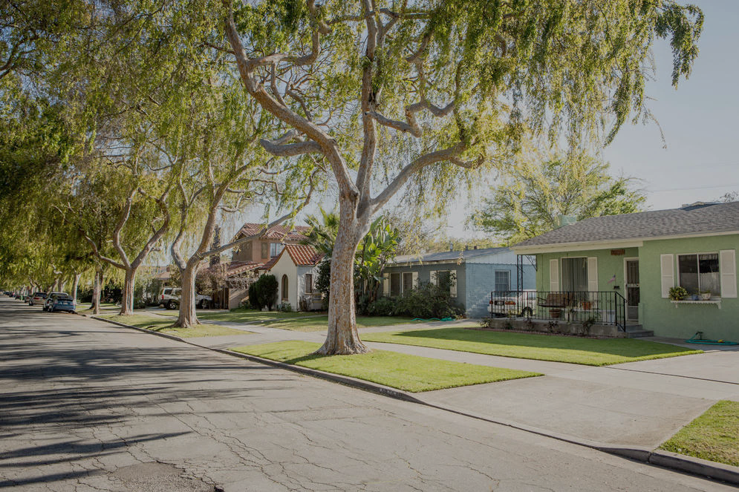
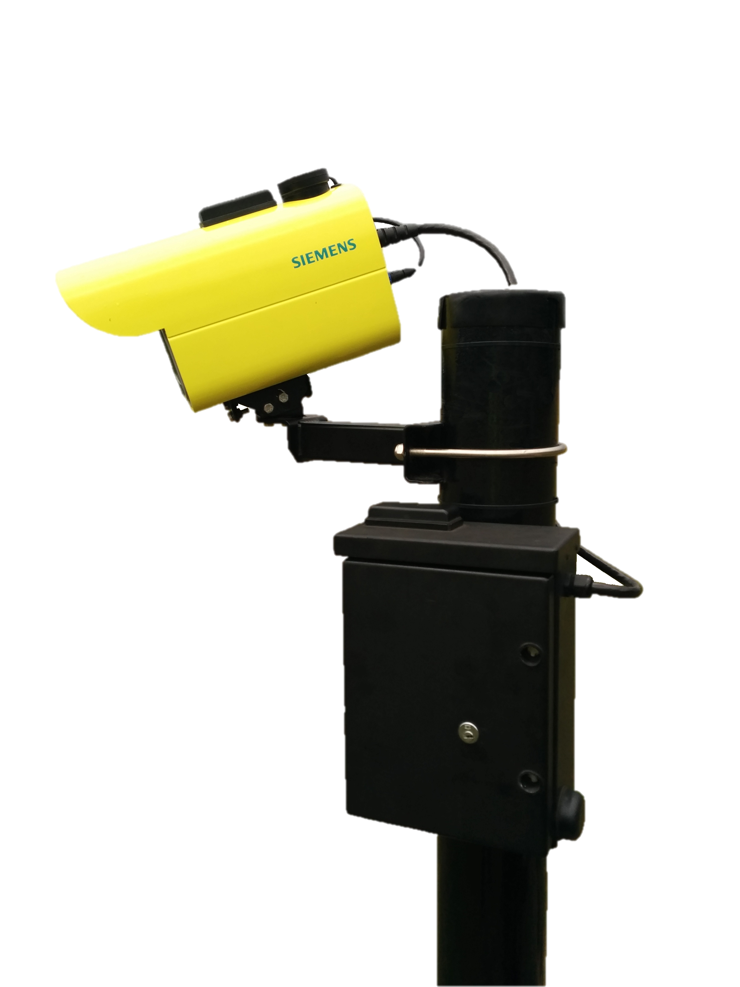
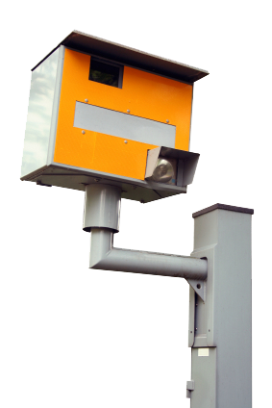
Motivation
Detrimental to streetscape
Discreet appearance
https://a1.muscache.com/locations/uploads/photo/image/22901/0_4200_0_2800_one_westside-los-angeles-quiet-residential-street-devon0289.jpg
Notes:
Regular average speed check cameras in all their yellow and orange glory are horrible to look at.
Putting a lot of them near homes would be detrimental to the streetscape, and therefore a discreet implementation is desired.

Slide 8
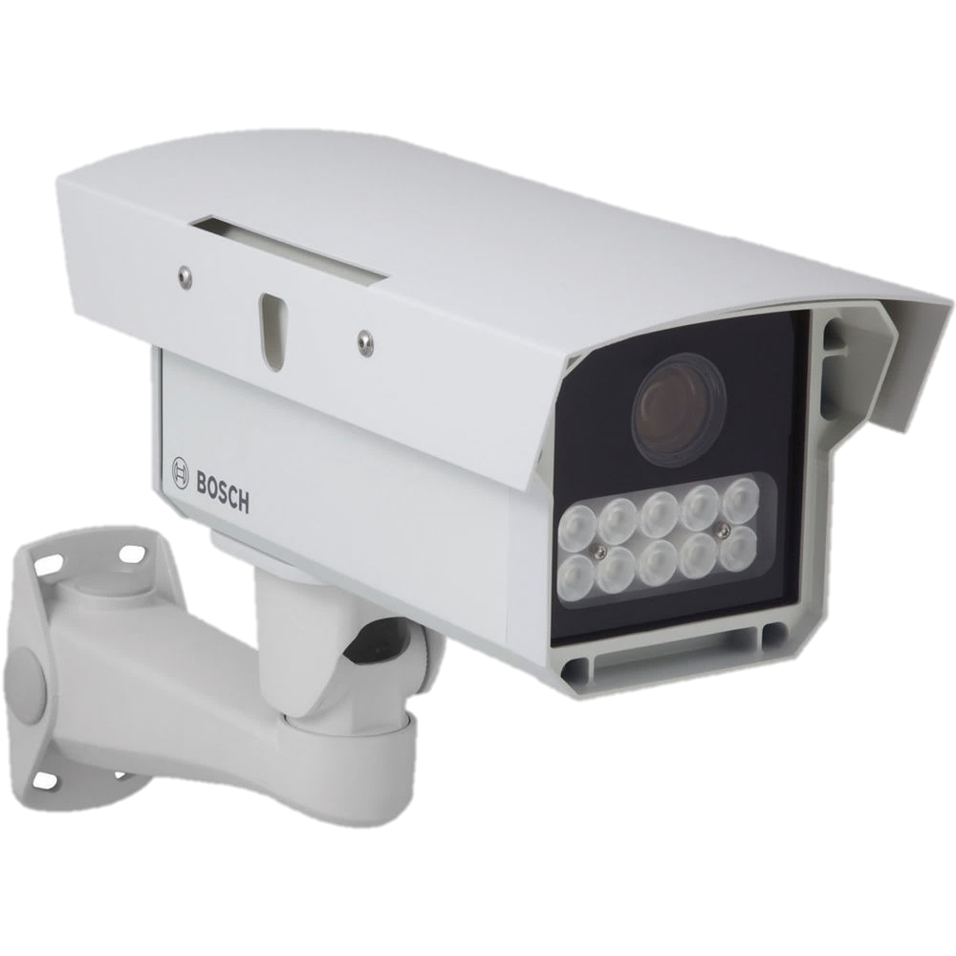
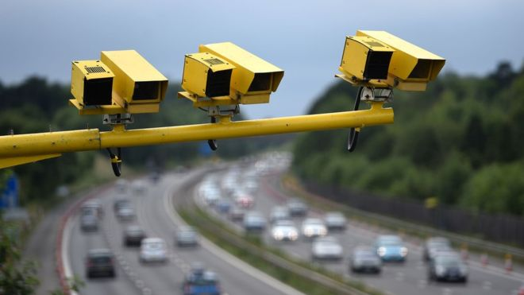
Related Work
Require dedicated camera hardware
>£ 1000
Uses centralised server to store plates
https://www.bhphotovideo.com/images/images1000x1000/bosch_f_01u_245_613_dinion_capture_5000_license_1163861.jpg
https://ichef-1.bbci.co.uk/news/660/cpsprodpb/0202/production/_89841500_033220635-2.jpg
Notes:
There are some license plate cameras on the market with different features like enhanced night time operation with superior digital signal processing.
However they are rather expensive and always use a central server to store the detected license plates.

Slide 9

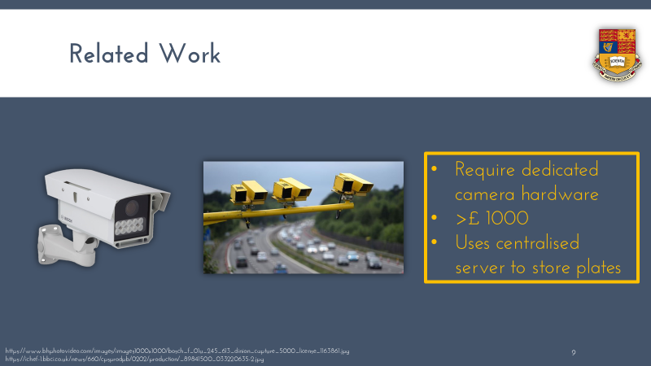

Slide 10
Agenda

Slide 11



Slide 12
Product Specification - Main Deliverables
Implement a UK number plate recognition system using existing computer vision algorithms on a low-cost, readily available hardware platform.
Set up a peer-to-peer network to share vehicle passing times and detect violations without the need for a central server.
Publish photo evidence of any violations
(Advanced deliverables in evaluation)
Notes:
Therefore, the main deliverables of the project were formulated as follows:
The system should leverage existing computer vision algorithms to provide license plate recognition capabilities
For sake of simplicity, no custom plates, and only UK format
A peer to peer network should be created to share the detected plates with no need for a central server
The license plates should be able to be published online for further police action

Slide 13
Product Specification - Main Deliverables
Implement a UK number plate recognition system using existing computer vision algorithms on a low-cost, readily available hardware platform.
Set up a peer-to-peer network to share vehicle passing times and detect violations without the need for a central server.
Publish photo evidence of any violations
(Advanced deliverables in evaluation)
Notes:
Therefore, the main deliverables of the project were formulated as follows:
The system should leverage existing computer vision algorithms to provide license plate recognition capabilities
For sake of simplicity, no custom plates, and only UK format
A peer to peer network should be created to share the detected plates with no need for a central server
The license plates should be able to be published online for further police action

Slide 14
Product Specification - Main Deliverables
Implement a UK number plate recognition system using existing computer vision algorithms on a low-cost, readily available hardware platform.
Set up a peer-to-peer network to share vehicle passing times and detect violations without the need for a central server.
Publish photo evidence of any violations
(Advanced deliverables in evaluation)
Notes:
Therefore, the main deliverables of the project were formulated as follows:
The system should leverage existing computer vision algorithms to provide license plate recognition capabilities
For sake of simplicity, no custom plates, and only UK format
A peer to peer network should be created to share the detected plates with no need for a central server
The license plates should be able to be published online for further police action

Slide 15
Product Specification - Main Deliverables
Implement a UK number plate recognition system using existing computer vision algorithms on a low-cost, readily available hardware platform.
Set up a peer-to-peer network to share vehicle passing times and detect violations without the need for a central server.
Publish photo evidence of any violations
(Advanced deliverables in evaluation)
Notes:
Therefore, the main deliverables of the project were formulated as follows:
The system should leverage existing computer vision algorithms to provide license plate recognition capabilities
For sake of simplicity, no custom plates, and only UK format
A peer to peer network should be created to share the detected plates with no need for a central server
The license plates should be able to be published online for further police action

Slide 16
Product Specification - Advanced Deliverables
Use the changes in the number plate geometry as the vehicle passes to detect the instantaneous speed of a vehicle
Implement automatic peer discovery
Add an encryption layer
Package the system so that it can be easily installed in a home by an inexperienced user.

Slide 17
Product Specification - Advanced Deliverables
Use the changes in the number plate geometry as the vehicle passes to detect the instantaneous speed of a vehicle
Implement automatic peer discovery
Add an encryption layer
Package the system so that it can be easily installed in a home by an inexperienced user.

Slide 18
Product Specification - Advanced Deliverables
Use the changes in the number plate geometry as the vehicle passes to detect the instantaneous speed of a vehicle
Implement automatic peer discovery
Add an encryption layer
Package the system so that it can be easily installed in a home by an inexperienced user.

Slide 19
Product Specification - Advanced Deliverables
Use the changes in the number plate geometry as the vehicle passes to detect the instantaneous speed of a vehicle
Implement automatic peer discovery
Add an encryption layer
Package the system so that it can be easily installed in a home by an inexperienced user.

Slide 20

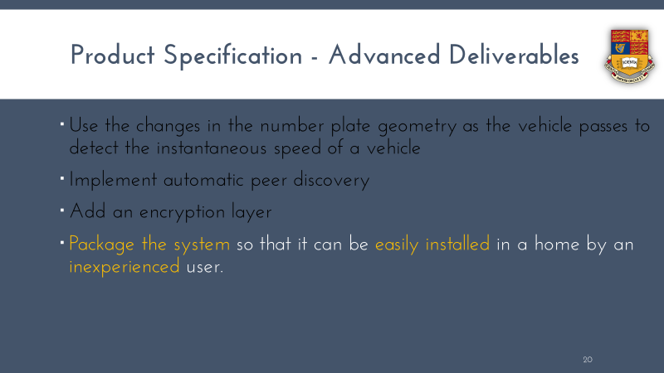

Slide 21
Agenda

Slide 22



Slide 23
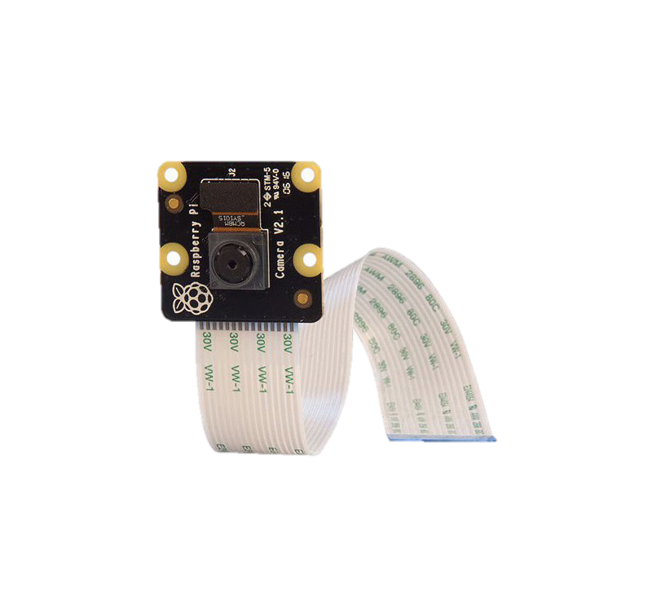

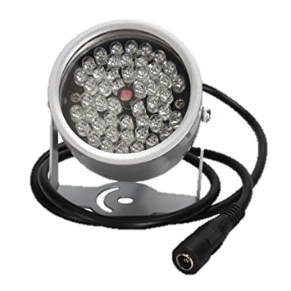
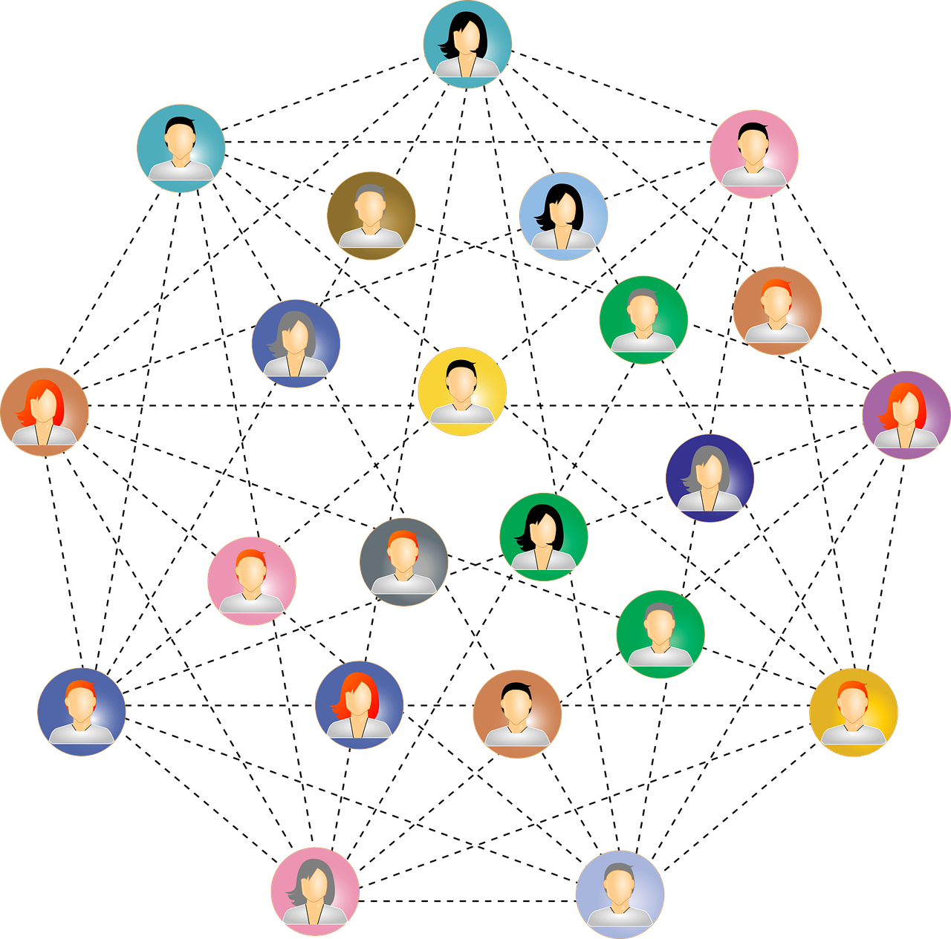
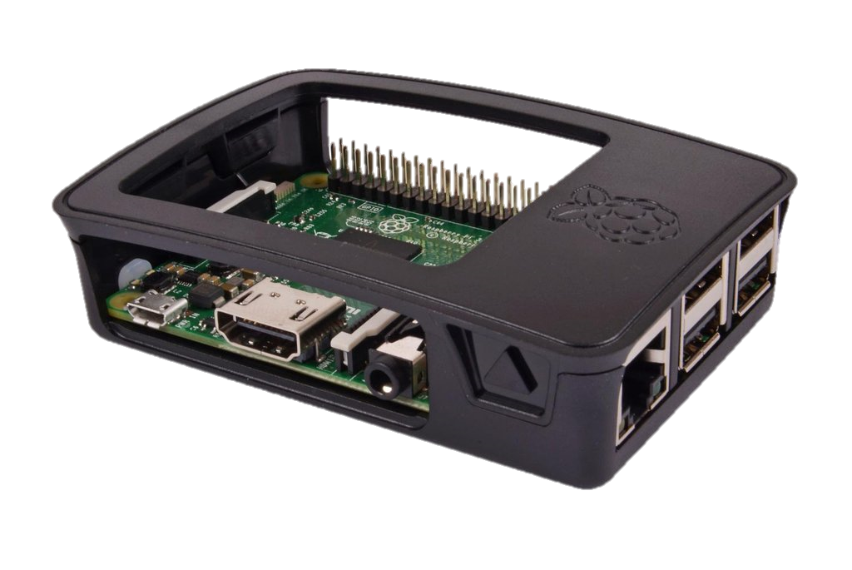


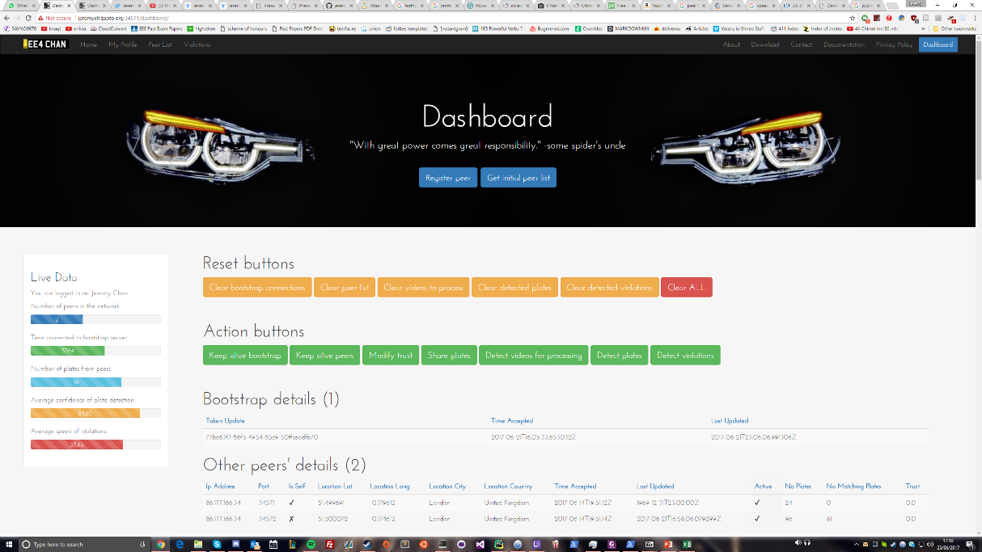
High Level Design
License Plate Detection
Peer to Peer Network
Web Interface
3 well defined modules
Readily available components
Users have control over data

Slide 24




Envisioned System
9:41 pm
9:41 pm
9:44 pm
9:44 pm
9:41 pm
9:44 pm

Slide 25

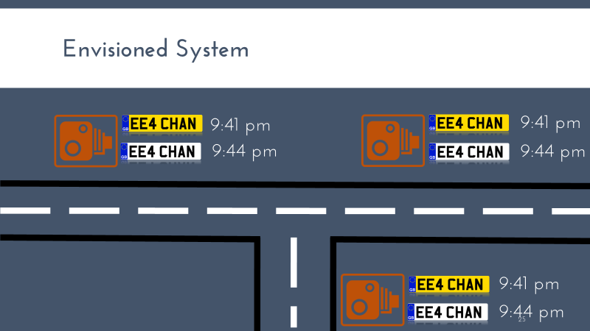

Slide 26
Agenda

Slide 27



Slide 28
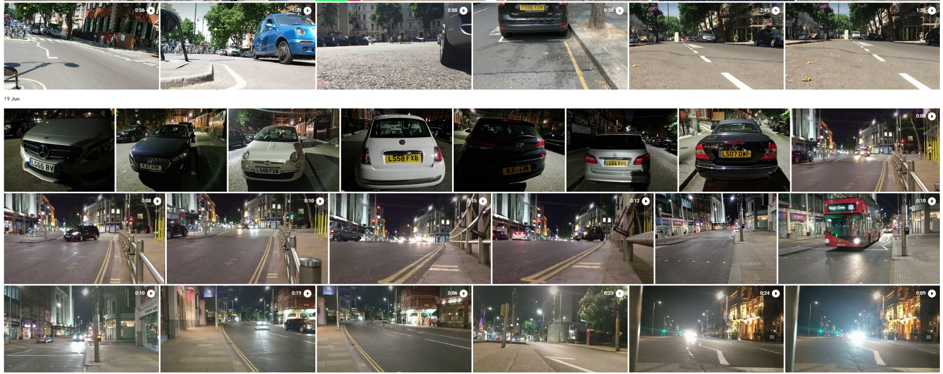
License Plate Recognition - Aim
Get license plates of cars
Function in multiple angles and lighting conditions

Slide 29
License Plate Recognition - Design
Store videos locally using motion detection
Detect license plates using OpenALPR
Extract unique plates
Multiple parameters for tweaking
Store plates with metadata in database
Consecutive frames will likely be the same car
Process videos when idle
Time
Location
Can survive power outages
Can survive busy periods

Slide 30
License Plate Recognition - Fuzzy Grouping
LG65FBO --- LG65FBP --- LG65FBO --- FE16RBX --- LTZ1077 --- LTZ077 --- LTZ107
Plate1 | Plate 2 | String Similarity
LG65FBO | LG65FBP | 0.857
LG65FBO | FE16RBX | 0.285
LG65FBO | LTZ1077 | 0.143
FE16RBX | LTZ1077 | 0.143
LTZ1077 | LTZ107 | 0.923
Robust separation of unique vehicles
Sort by confidence
Works with misreads

Slide 31
License Plate Recognition - Fuzzy Grouping
LG65FBO --- LG65FBP --- LG65FBO --- FE16RBX --- LTZ1077 --- LTZ077 --- LTZ107
Plate1 | Plate 2 | String Similarity
LG65FBO | LG65FBP | 0.857
LG65FBO | FE16RBX | 0.285
LG65FBO | LTZ1077 | 0.143
FE16RBX | LTZ1077 | 0.143
LTZ1077 | LTZ107 | 0.923
Robust separation of unique vehicles
Sort by confidence
Works with misreads

Slide 32
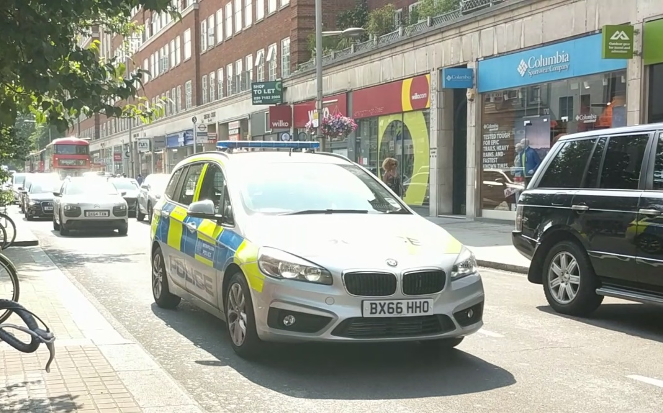
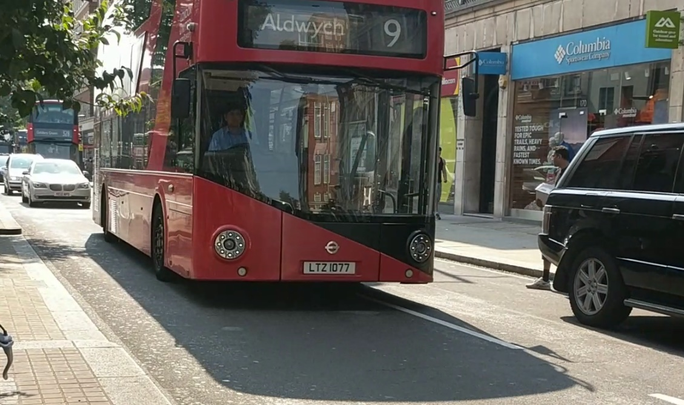
License Plate Recognition - Testing
BX66HHO
LTZ1077

Slide 33
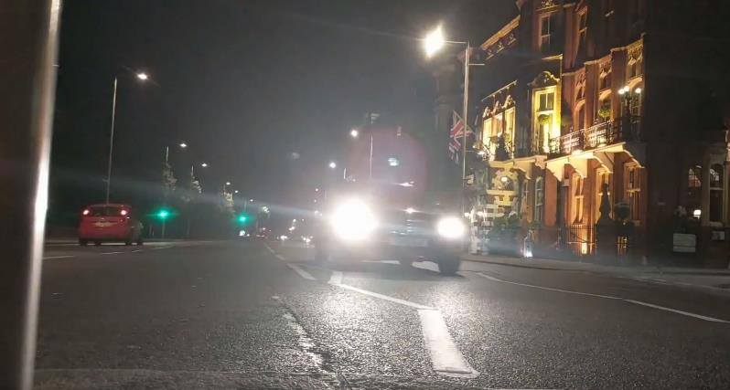
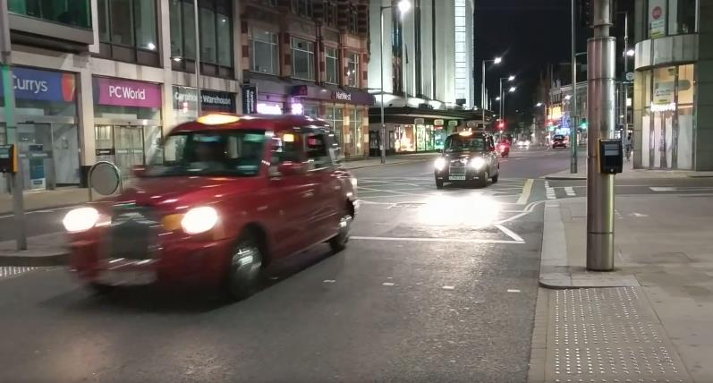
License Plate Recognition - Testing
--
--

Slide 34
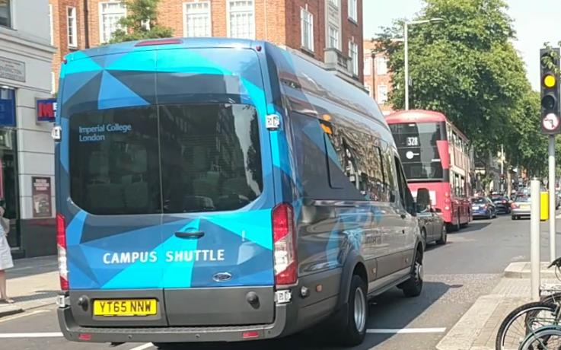
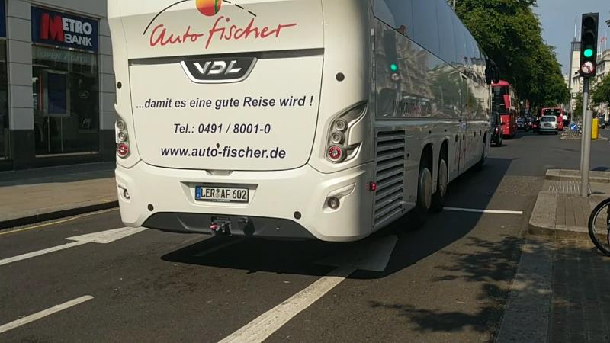
License Plate Recognition - Testing
5HUTTLE
18001

Slide 35






License Plate Recognition - Matching
@ Letter
# Number
@@##@@@ or @@@####

Slide 36
License Plate Recognition - Matching
@ Letter
# Number
@@##@@@ or @@@####
Max 100%

Slide 37
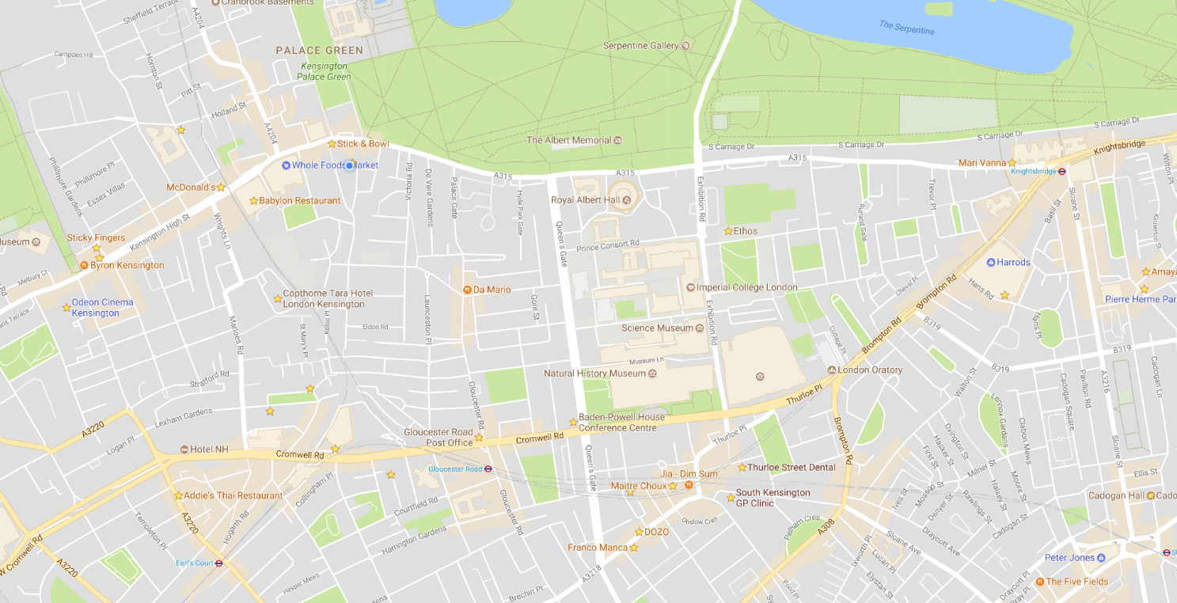
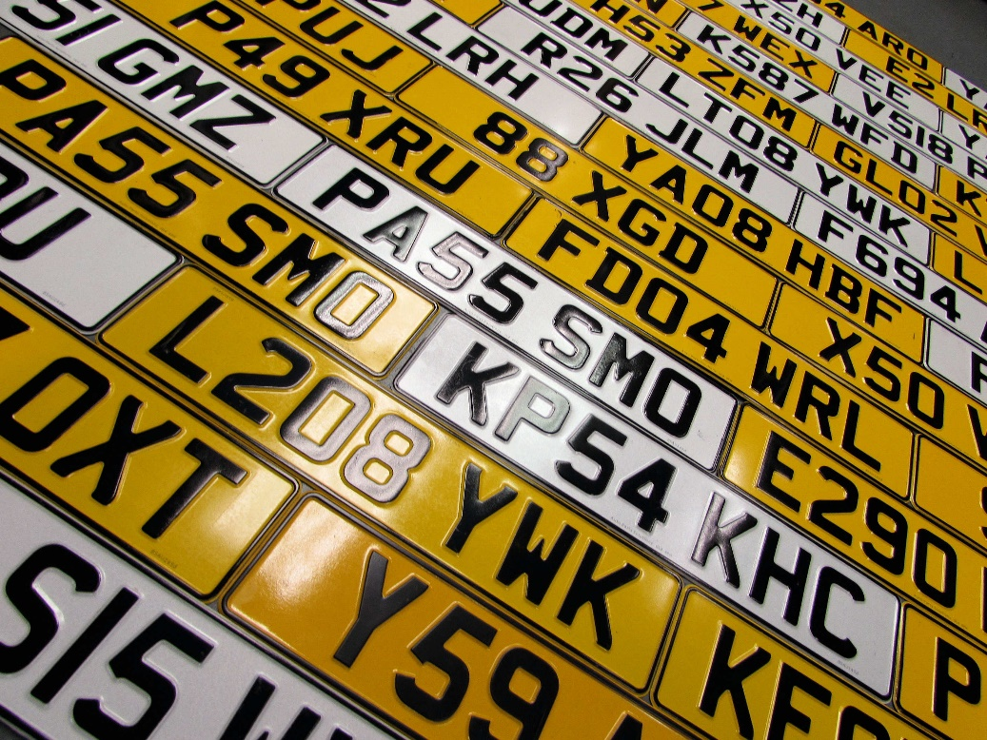
Peer to Peer Network - Aim
Transmit detected plates to other peers
Work out average speed between peer locations
http://pressednumberplates.co.uk/wp-content/uploads/2016/06/Pressed-Number-Plates.jpg

Slide 38
Peer to Peer Network - Aim
http://pressednumberplates.co.uk/wp-content/uploads/2016/06/Pressed-Number-Plates.jpg

Slide 39
Peer to Peer Network - Server
GET
POST
PATCH
DELETE
RESTful API
Run on top of a web server
Can be used for the web interface too

Slide 40
Peer to Peer Network - Server
GET
POST
PATCH
DELETE

Slide 41
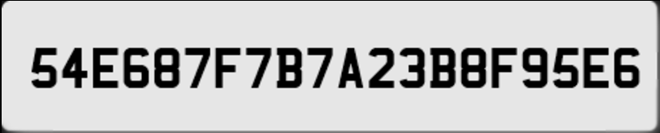
Peer to Peer Network - Server
ID: fbbb1cbf-7887-4cc6-9bbf-16707e11367e
ID: 01ed4cfa-6c5b-476f-a6f8-4c6d0bcd5975
GET
POST
PATCH
DELETE
encryption
authentication
ID: 4feb662e-f50a-4088-bafe-ce75b421d50c

Slide 42
Peer to Peer Network - Server
ID: fbbb1cbf-7887-4cc6-9bbf-16707e11367e
ID: 01ed4cfa-6c5b-476f-a6f8-4c6d0bcd5975
GET
POST
PATCH
DELETE
encryption
authentication
ID: 4feb662e-f50a-4088-bafe-ce75b421d50c
API
Unique ID authentication
Local encryption

Slide 43
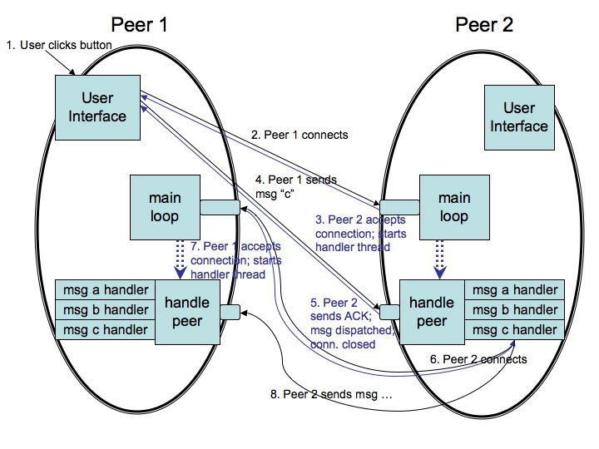
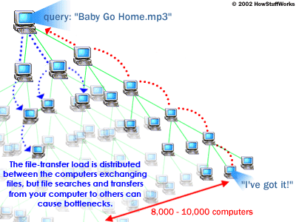
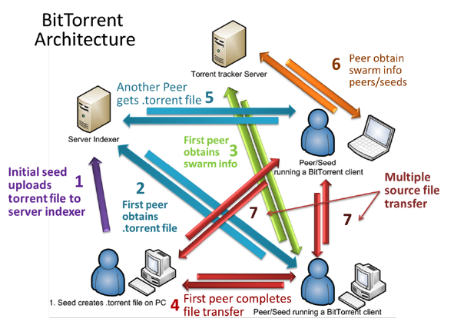
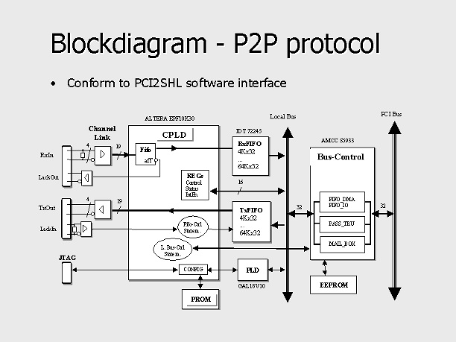
Peer to Peer Network - Design
Overkill for transferring text
Risky considering project timescale
Program security protection manually
http://cs.berry.edu/~nhamid/p2p/diagram1.jpg
https://www.researchgate.net/profile/Houssain_Kettani/publication/241972547/figure/fig1/AS:298617555439620@1448207381487/Figure-2-Classical-BitTorrent-P2P-Protocol-Sequence.png
http://www.umkc.edu/is/security/images/P2P_Explanation/gnutellaProtocol.gif
https://www-zeuthen.desy.de/technisches_seminar/texte/flink_se/img008.jpg

Slide 44







Peer to Peer Network - Design
Tried, tested, scalable framework
Most security issues taken care of

Slide 45
Peer to Peer Network - Trust System

Slide 46
Peer to Peer Network - Trust System

Slide 47
Peer to Peer Network - Trust System
Reward genuine, matching plates
Prevent fake plates
Prevent leeching

Slide 48
Peer to Peer Network – Network Transactions
Register
Get list of peers
Keep alive
Send plates
Detect violations
Modify trust of peer
Bootstrap the network
Maintain the network
Security issues
Adapted from https://en.wikipedia.org/wiki/Peer-to-Peer_Protocol_(P2PP)

Slide 49
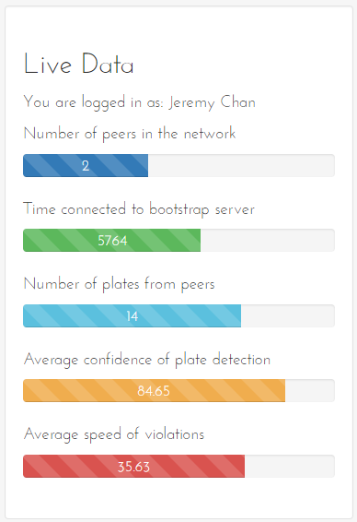
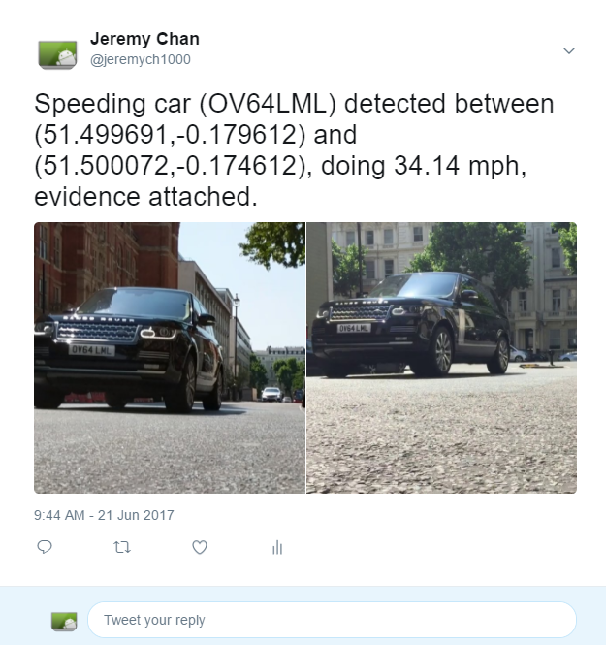
Web Interface - Aim
What the user sees
Dashboard to control network
Post detected violations on social networks

Slide 50
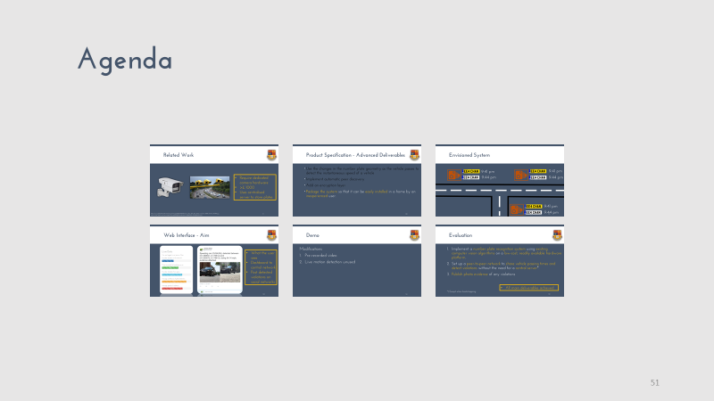
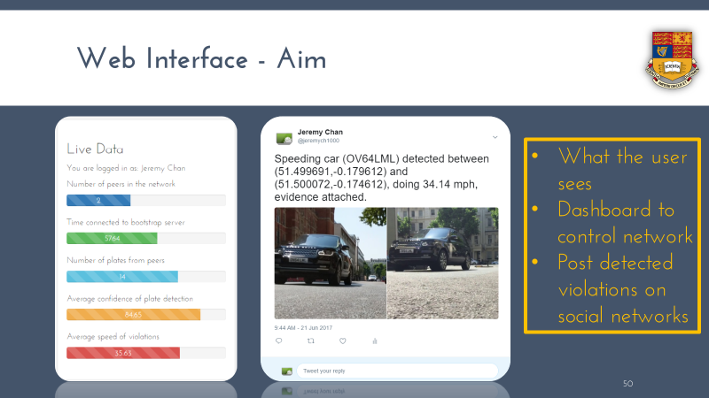

Slide 51
Agenda

Slide 52



Slide 53
Demo
Modifications
Pre-recorded video
Live motion detection unused

Slide 54
Demo
Modifications
Pre-recorded video
Live motion detection unused

Slide 55



Slide 56
Agenda

Slide 57



Slide 58

Evaluation
Implement a number plate recognition system using existing computer vision algorithms on a low-cost, readily available hardware platform.
Set up a peer-to-peer network to share vehicle passing times and detect violations without the need for a central server*.
Publish photo evidence of any violations
All main deliverables achieved
*) Except when bootstrapping

Slide 59
Evaluation
Use the changes in the number plate geometry as the vehicle passes to detect the instantaneous speed of a vehicle
Implement automatic peer discovery
Add an encryption layer
Package the system so that it can be easily installed in a home by an inexperienced user.
All but 1 advanced deliverable achieved

Slide 60
Conclusion
Challenging project
Very open ended on implementation
Usable immediately
Revisit performance and night time issues with LPR
Consider refactoring P2P to be standalone
Scalability testing
Attempt overnight test

Slide 61
Thank you
http://github.com/jeremych1000/ee4-FYP/
©2017 Jeremy Chan. All rights reserved. | Powered by Django and OpenALPR | Created with love from the United Kingdom

